Slide 1
Distributing systems using Azure Service Bus

Slide 2
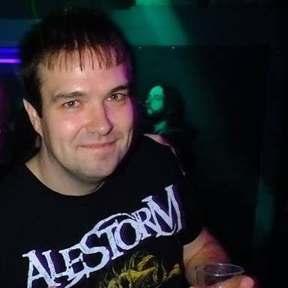
About me
10+ years experience as a full stack engineer
As of this week I work for LaunchB!
Experience working high volume distributed systems
I love heavy metal :D
https://github.com/PeterStephenson
Everything from this session is in the asb-session repo ☺

Slide 3
The day after tomorrow…
Who works in retail/e-commerce?
What’s tomorrow?
Where would you rather work on Monday morning?

Slide 4
What can be done?
Distribute
Scale out
More fault tolerant
Geo-locate services near customers
Create smaller, more focused services
Comprehensive monitoring
Notes:
Scale out
Cheaper to buy multiple cheap computers than try and go “more powerful”
Limits on how far you can scale up
More fault tolerant
Distributed system includes multiple identical workers, losing one only affects throughput
You can patch the system easily
Geo-locate services near customers
Faster performance – round trips from the US to the UK do take time!
Create smaller, more focused services
Easier to deploy
Easier to maintain
Can throw away and rewrite if needed
Comprehensive monitoring
You need to know if you need to scale
Monitor dependencies and processing rates

Slide 5
How can Azure Service Bus help?
Queueing
Decouple services
Distribute work
Website
Payments
OrderPlaced
Azure Service Bus
OrderPlaced
OrderPlaced
E-Mail
Warehouse
OrderPlaced
Notes:
Queueing
Spread the load – no need to pay for capacity to process everything immediately if you have hours to process things
Decouple services
Publish/Subscribe model means that services can be decoupled
A single bus allows easy integration of new services
Event based, choreographed, small services are easy to reason about
Distribute work
Competing consumer queues allow multiple workers to be deployed
Example
Website can “fire and forget” orders
Process the payment as soon as possible
Get them to the warehouse soon after
Email the customers after key events

Slide 6
How can Azure Service Bus help?
Queueing
Decouple services
Distribute work
Website
Payments
OrderPlaced
Azure Service Bus
OrderPlaced
OrderPlaced
E-Mail
Warehouse
OrderPlaced
Notes:
In this setup if one service goes down, orders can still be taken and messages will queue for delivery when the service recovers

Slide 7
Building Blocks
Topics
Publish-Subscribe Messaging
Queues
First in first out
Chainable
Topics can auto-forward to other topics/queues
Notes:
Topics
Publish-Subscribe Messaging
Useful for connecting services together
Other services can create subscriptions in the topic and receive a copy of every message that is published on it
One service can publish an event when something happens and many other services can respond
For example: A service publishing an event when a user is created can result in the email service sending a welcome email
Queues
First in first out
Useful for distributing work between multiple competing consumers
Work is added to the queue and removed roughly FIFO (be careful is you rely on exact message ordering!)
Can be chained together
Subscriptions on a topic can forward
You can forward to other topics or queues
Forwarding to queues and having a local subscription are similar but you move the data storage requirement to the queue rather than the topic
Forwarding to queues also allows you to have a single input queue for a logical service that subscribes to events from multiple topic

Slide 8
Topologies
Lots of ways to assemble the building blocks
Topic per message
Topic per publisher
“bundle topic”
Like NServiceBus
Some thought is needed when designing the system

Slide 9
SDK
Nuget: Microsoft.Azure.ServiceBus
Clients
QueueClient
TopicClient
SubscriptionClient
Manual serialisation required natively
Wrappers can help
MassTransit
NServiceBus

Slide 10
Demo
Basic forwarding topology
Topic: user
Queues: email-service, profile-service
Subscriptions: user-emails-usercreated, user-profile-usercreated
Forwards from Topic to relevant Queue
Basic Services
Publisher representing a user creation service
Subscribers representing
an email service
A profile creation service

Slide 11

Q+A

